Slide 1
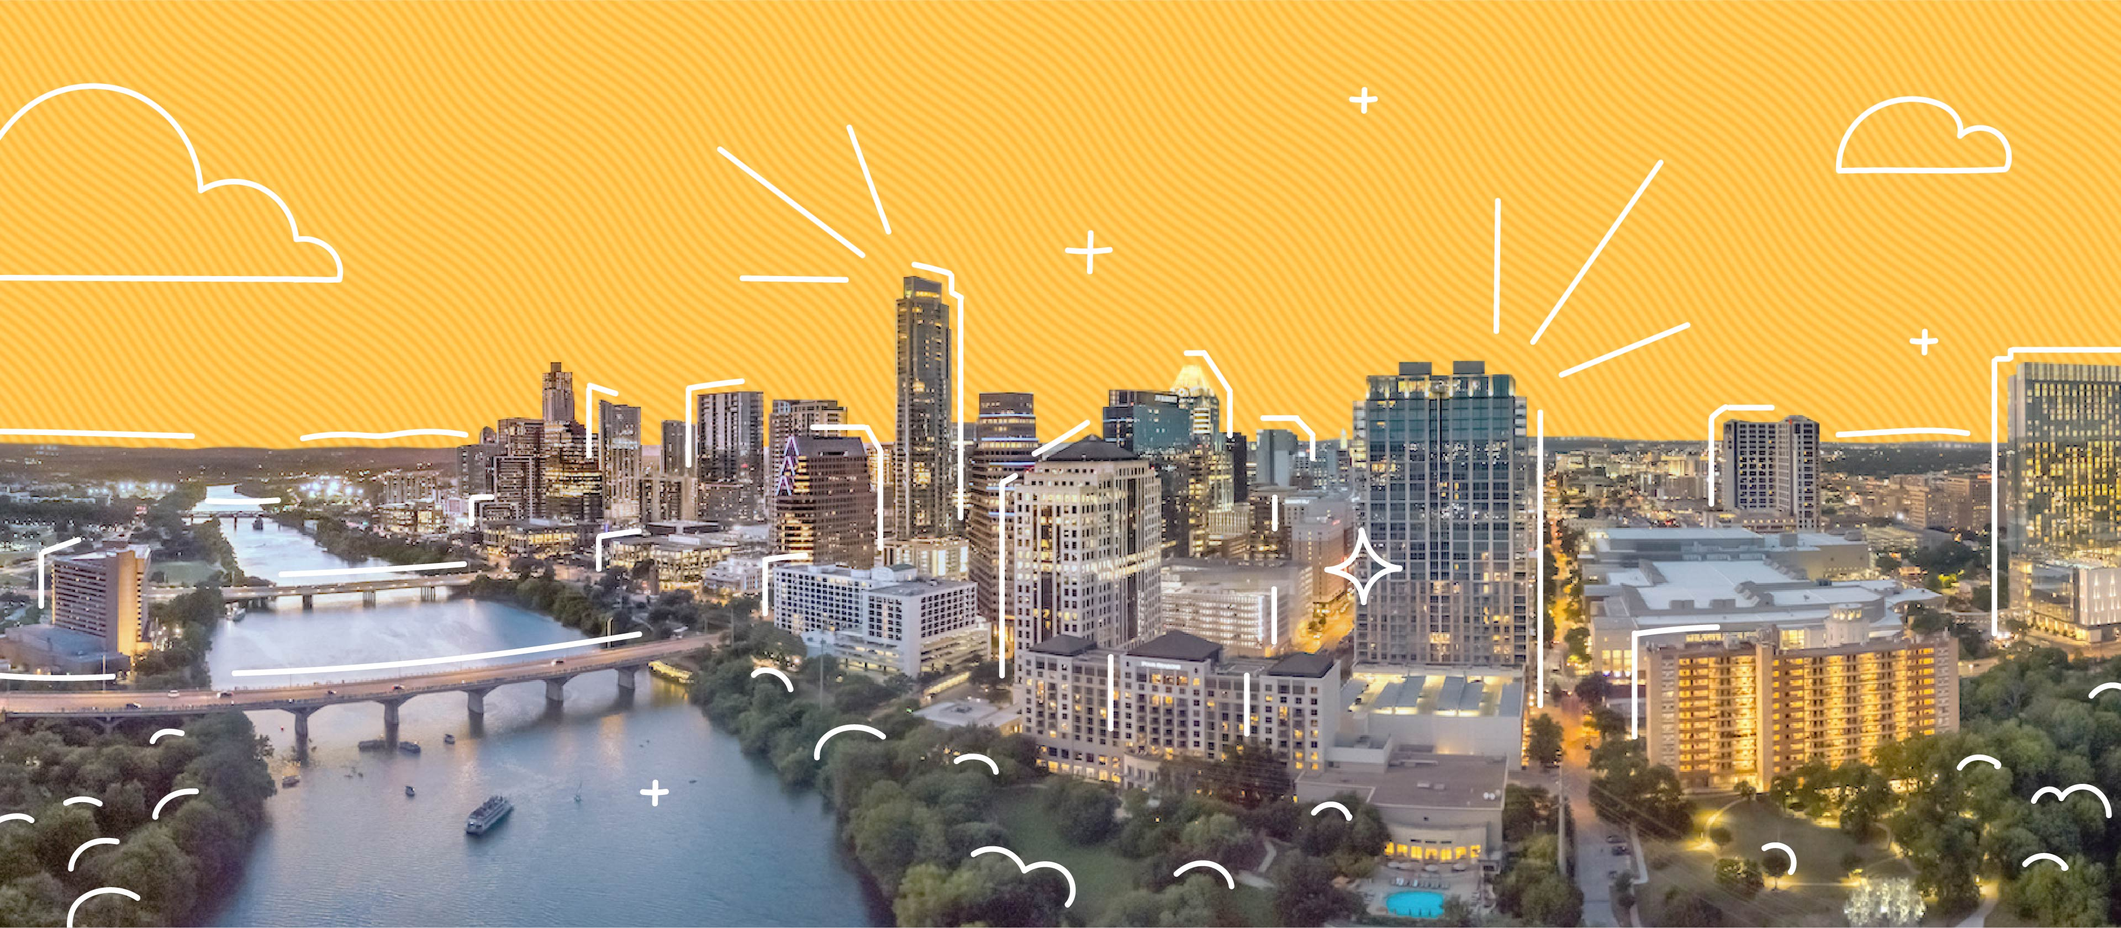
COS 214 Project
sudo-apt-get-marks

Slide 2
sudo-apt-get-marks members
u22497082 - Ethan Vletter
u22652974 - Carinda Smith
u23632730 - Janri du Toit
u23577674 - Ethan Wilke
u23656175 - James Neale
u23708833 - Megan Pretorius
u23590883 - Marco Paximadis

Slide 3

Introduction
In this world made up of billions of unique personalities, all with thoughts of our own, there is one thing that we all dream of nightly. Being your own communist government in a terminal-based city builder.
We at sudo-apt-get-marks recognized this longing desire. Using the software modelling techniques learnt in COS214, we were able to bring this dream to life.
Our program allows our users to create buildings, provide jobs for our citizens, supply them with power and much more.
We start this product presentation off with details about all the design patterns we used.

Slide 4
Final class diagram

Slide 5

City Management:
Create and manage different types of buildings.

Slide 6
Buildings
Add class diagram

Slide 7
Buildings
Explain pattern and attributes and methods

Slide 8

City Management:
Manage Utilities
Powerplants : generate electricity to supply to city.
Functional and Non-functional
Water Supply : ensure steady distribution of water.
Functional and Non-functional
Waste Management : handle waste removal and recycling.
Functional and Non-functional

Slide 9
Utilities
Add class diagram

Slide 10
Utilities
Utilities allow the city to be cleaned and aid in the production of certain resources in the city. E.g. Powerplants increase the amount of energy that is produced.
Utilities implements the state design pattern. Utilities appear to change their class through the repair and malfunction functions.
A utility that has malfunctioned operates at a lower efficiency and can be repaired to operate at max efficiency again.
The government acts as the context class. Natural disasters cause utilities to malfunction. The user can choose to repair utilities when they have malfunctioned.

Slide 11
Utilities
State: PowerPlant, WasteManagement, WaterSupply
ConcreteStates: FunctionalPowerPlant, NonFunctionalPowerPlant
Context: Government

Slide 12
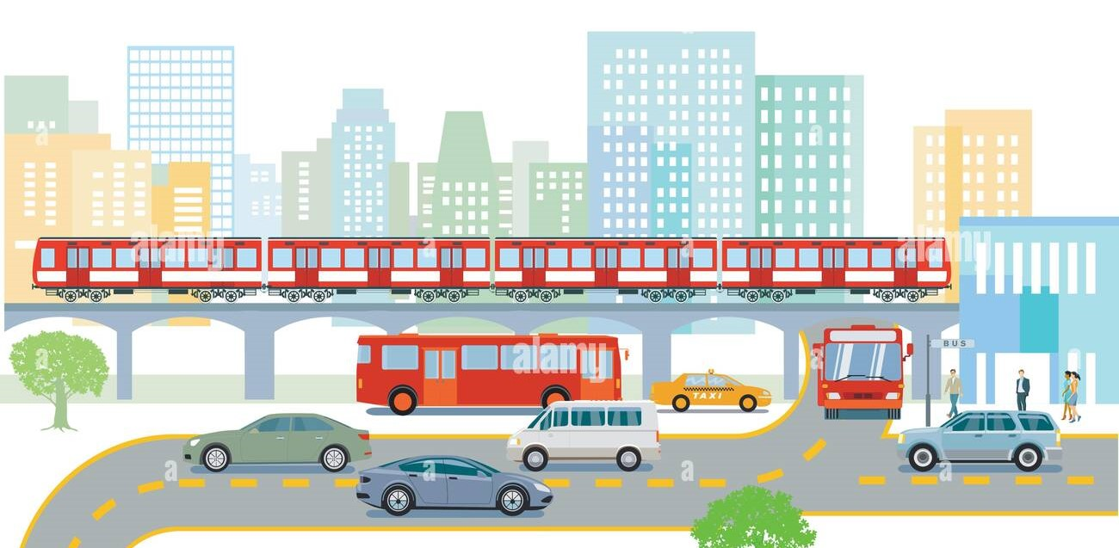
City Management:
Handle Transportation system.
Roads: Basic infrastructure for public transport movement.
Public Transit: Buses to transport citizens to and from place of employment.
Commercial busses transport Commercial Workers to/from
Residence: House to/from Workplace: shop/mall/office on a Commercial road
Government busses transport Government Workers to/from Residence: Mansion to/from Workplace: school/hospital/government on a Government road
Industrial busses transport Industrial Workers to/from Residence: Apartment to/from Workplace: warehouse/plant/factory on an Industrial road
Trains: Transport materials on railways

Slide 13
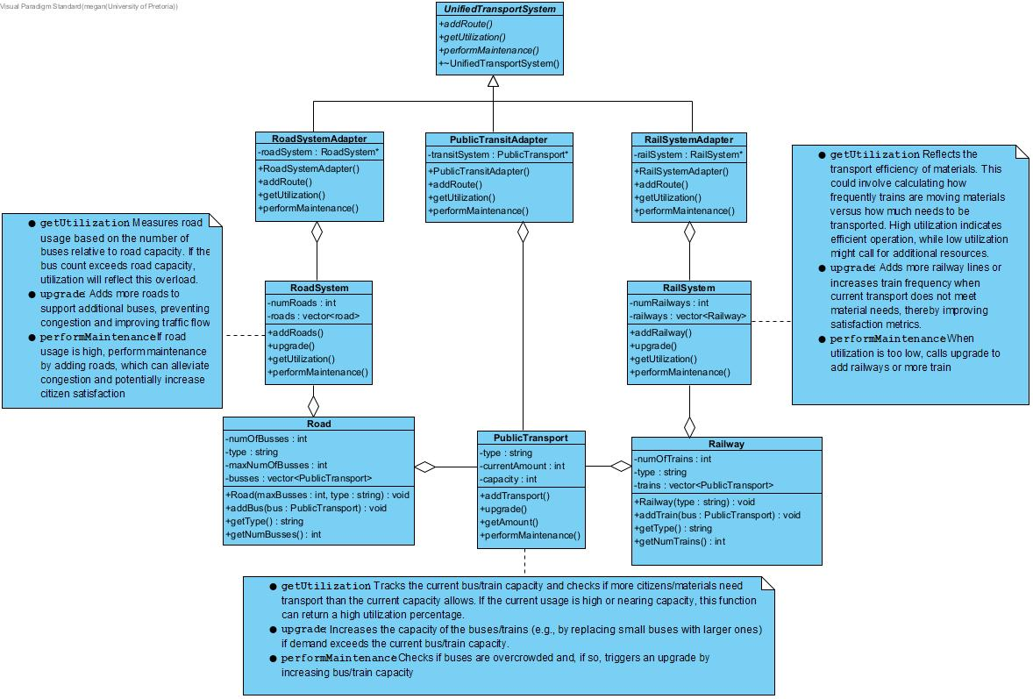
Transportation

Slide 14
Transportation
Explain pattern and attributes and methods

Slide 15
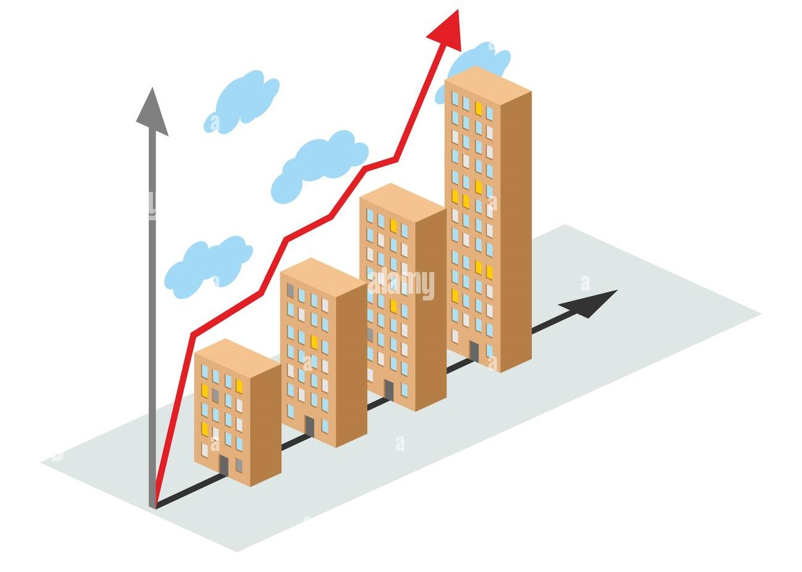
City Management:
City creation and growth Pattern used: Composite pattern
The CityGrowth class inherits from the CitySector class and serves as an overview of the city, such as the different CitySectors and all the types of Buildings in those Sectors as well as Citizens in the Buildings.
CityGrowth contains a vector of all the Sectors in the City.
CitySector contains a vector of all the Buildings in the Sector.
Certain buildings might contain a vector of all the Citizens in the Building.

Slide 16
City Management:
Add class diagram

Slide 17
City Management:
Composite pattern:
Component: CitySector
Composite: CityGrowth
Leaf: Buildings
Leaf and Composite inherit from Component, and Composite may contain multiple children that are Components

Slide 18
Resources
Resources
Materials : Abstract class for managing different resources.
Concrete: obtain and refine concrete
Steel: obtain and refine steel
Wood: obtain and refine wood
Energy : Manages different types of energy sources.
Coal, Hydro, Wind, Solar
Water : Manages the supply of water to the city.
Budget : Manages the city’s financial resources.
Cash, Debt

Slide 19
Resources:
Add class diagram

Slide 20
Resources:
All the resources implement the singleton design pattern. This ensures each resource has only one instance. A city can only have one of each resource.
Resources are used throughout the city to build, upgrade and maintain infrastructure.
The abstract Materials class and its respective base classes implement the template method. The increase() method in Materials calls the abstract functions obtain() and refine(), since different materials are increased differently.

Slide 21
Resources
Design patterns
Singleton :
Singletons: Energy, Budget, Water, Steel, Wood, Concrete
::getInstance() returns the instance of the singleton
Template Method:
AbstractClass: Material
ConcreteClasses: Wood, Steel, Concrete

Slide 22

Taxes
TaxSystem
Pattern used: Strategy pattern
The TaxSystem has different taxStrategy options to use when taxing Citizens.
The TaxSystem uses CityGrowth to find all taxable Citizens and calculates the tax amount using the desired strategy FlatTaxStrategy will calculate taxes based on the Citizens occupations.
ProgressiveTaxStrategy will calculate taxes based on the Citizens occupations, but this amount will increase depending on the number of Citizens in the City.
Taxes are collected once every 8 moves in the game.

Slide 23
Taxes
Add class diagram

Slide 24
Taxes
Strategy pattern:
Strategy: TaxStrategy
ConcreteStrategyA: FlatTaxStrategy
ConcreteStrategyB: ProgressiveTaxStrategy
Context: TaxSystem
TaxSystem holds and instance of the current selected TaxStrategy.
The Government holds an instance of the TaxSystem and can decide what Strategy to use when Taxing the City.

Slide 25
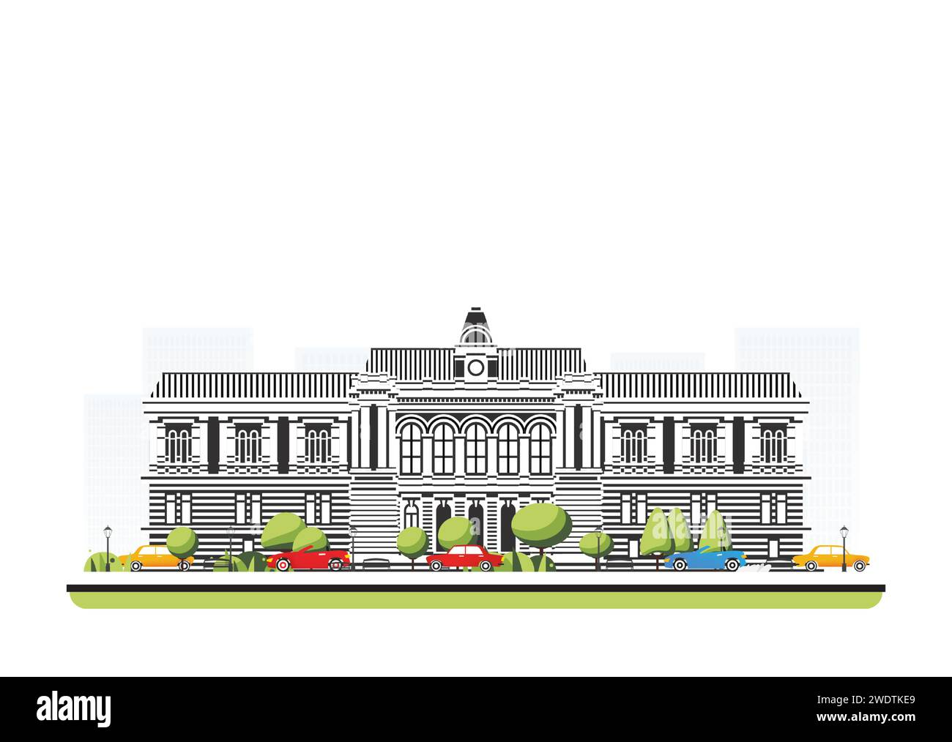
Government
Explain government

Slide 26
Government
Add class diagram

Slide 27
Government
Explain pattern , attributes and methods

